Slide 1


Innovating with Drone Technology
Industrial Inspection
July 10, 2015
Kevin.J.Alwell

Slide 2


Industrial Drone Inspection

Slide 3
















Early Adopters
Is this Idea Crazy?
or
Am I Crazy?
These Leading Early Adopters don’t seem to think so.
Industry Leaders already taking advantage of Drone enabled Industrial Inspection.

Slide 4
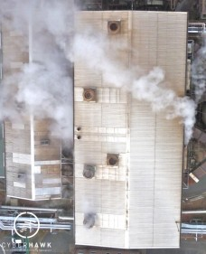
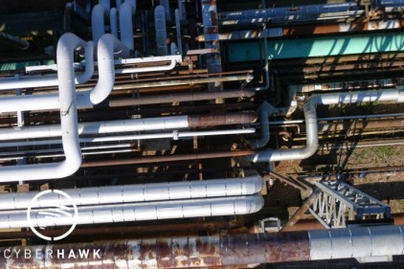
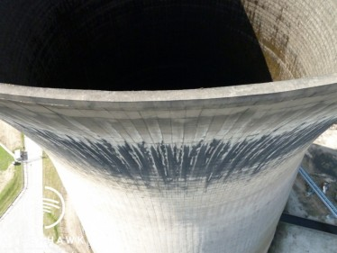
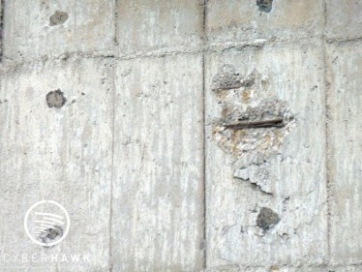
Getting Progressive: –Structural Inspection-
Infrastructure : Power lines : Plant Assets
Benefits:
- Reducing Cost with minimal downtime.
- Faster Inspection time compared to traditional methods.
- Focus maintenance teams on repairing identified problems rather than using up valuable circuit outage time for fault finding.
- Safe Environment No need to work at Height

Slide 5
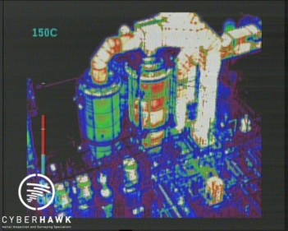
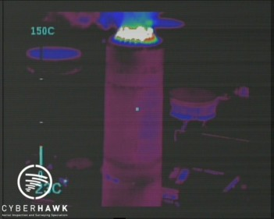
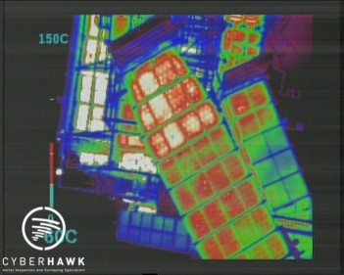
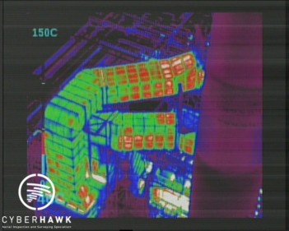
Getting Progressive: –Thermal Inspection-
Infrastructure : Power lines : Plant Assets
Benefits:
- Identify gas leaks, burn back and refractory breakdown.
- Enable thermography engineers with drone compatible thermo sensor technology.
- De-risk planned shutdowns with information to fully plan and budget turnarounds.
- Focus maintenance teams on repairing identified problems rather than using up valuable circuit outage time for fault finding.

Slide 6
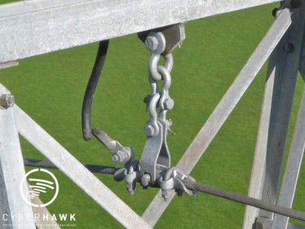
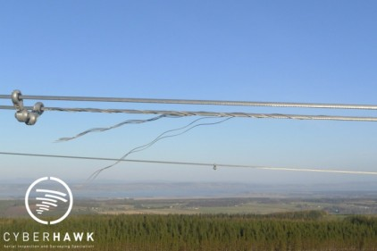
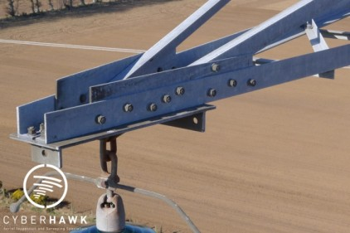
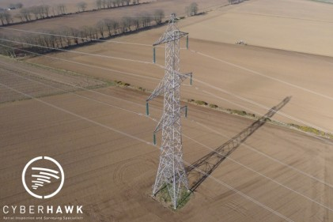
Getting Progressive: –Power Line Inspection-
Infrastructure : Power lines : Plant Assets
Benefits:
- No plant outage during inspection.
- Comprehensive close visual inspection.
- Significantly improves safety performance by reducing the amount of “at height” working required and by limiting our Inspectors exposure to power lines.
- Higher quality Info: Equipment can get close to assets and allow for experts to locate and diagnose problems quickly.

Slide 7


Enabling our Drones

Slide 8
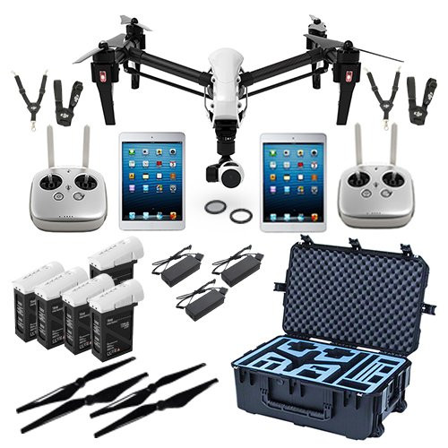
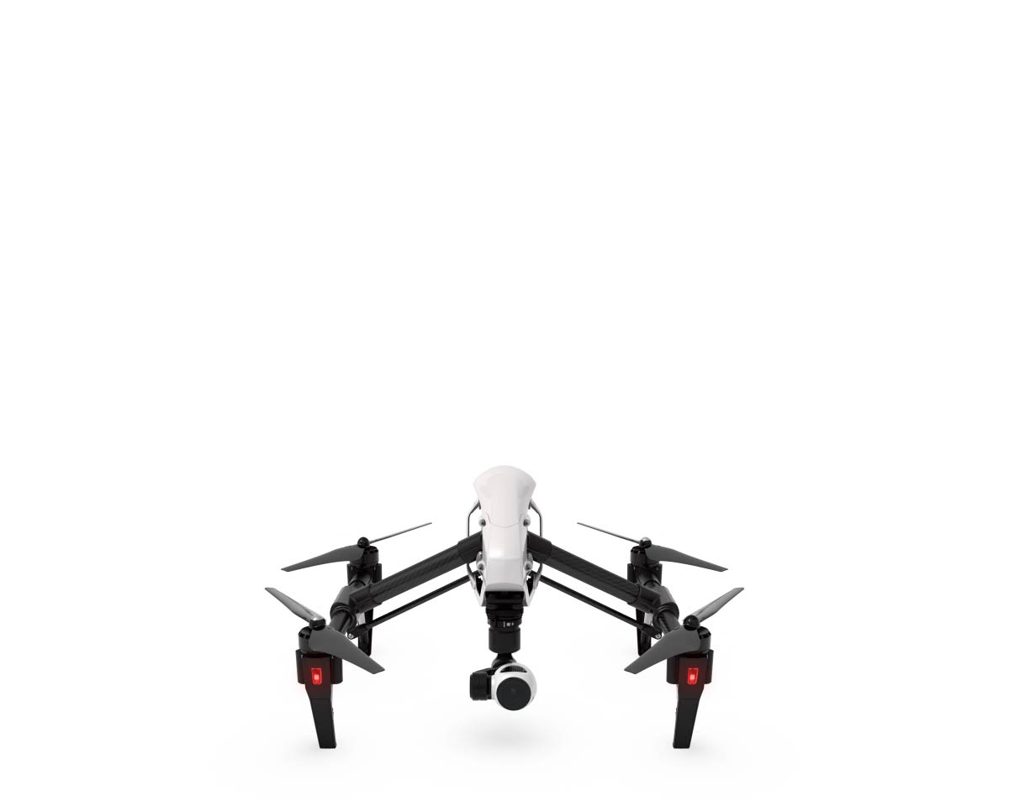
DJI Inspire-1
Specs:
- 4k Video @ 30FPS
- 20min Flight time
- Professional Flight Control System
- 3 axis gimbal stabilized camera
- HD wireless video transmission
- Full remote camera control capability
- App controlled manual camera settings
- Thermal Sensor not included
$5439
$3399

